Slide 1

Chapter 4

Slide 2
Another method of the window object that displays a dialog box – page 109
Two methods of the window object for working with numbers

Slide 3
Three methods of the document object
Examples of document methods

Slide 4
Members of the Textbox object – page 111

Slide 5
HTML tags that define two text boxes
How to use the value property to get the value from a text box

Slide 6
How to use the parseFloat method to get a number value from a text box

Slide 7
How to create a JavaScript object – page 113
A few of the methods of a Date object

Slide 8
Properties and methods of a String object

Slide 9
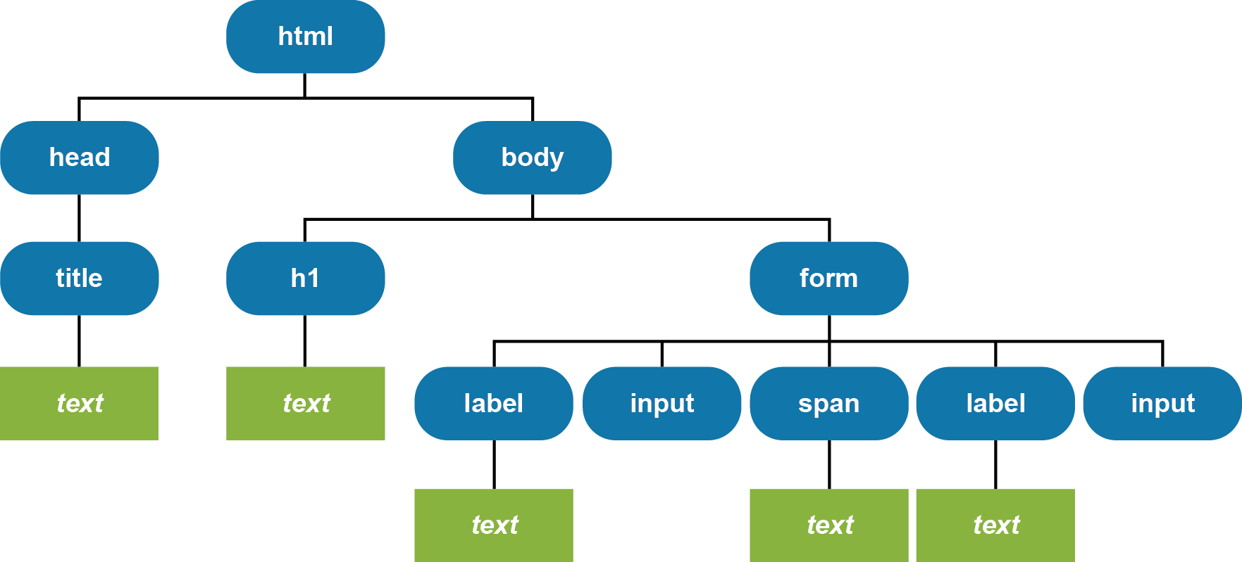
The DOM for the web page – page 115

Slide 10
The syntax for a function expression – page 117
var variableName = function(parameters) {
// statements that run when the function is executed
}[;]
A function expression with one PARAMETER that returns a DOM element – do not use $!!
const xFnDef = function (id) {
return document.getElementById(id).value;
};
A statement that calls the xFnDef function with one argument
const emailAddress1 = xFnDef("email_address1");

Slide 11
A function expression with no parameters that doesn’t return a value
A statement that calls the showYear function with no parameters
parameters are the variable placeholders defined inside a function's signature
arguments are the actual values passed into those placeholders when the function is called

Slide 12
A function expression with two parameters that returns a value

Slide 13
The syntax for a function declaration – page 119
A function declaration with two parameters that returns a value

Slide 14
Es6 – The syntax for an arrow function
const constantName = (parameters) => {
// statements that run when the function is executed
};
The code for a function expression
const calculateTax = function(subtotal, taxRate) {
const tax = subtotal * taxRate;
return tax.toFixed(2);
};
The code rewritten as an arrow function
const calculateTax = (subtotal, taxRate) => {
const tax = subtotal * taxRate;
return tax.toFixed(2);
};

Slide 15
Es6 – An arrow function with one parameter
const calculateTax = subtotal => {
const tax = subtotal * 0.074;
return tax.toFixed(2);
};
An arrow function with one parameter that executes one statement
const calculateTax = subtotal =>
(subtotal * 0.074).toFixed(2);
An arrow function with no parameters that executes one statement
const getCurrentUrl = () => document.location.href;
How to call an arrow function
const url = getCurrentUrl();

Slide 16
A function that uses a local variable named tax – page 121
A function that uses a global variable named tax

Slide 17
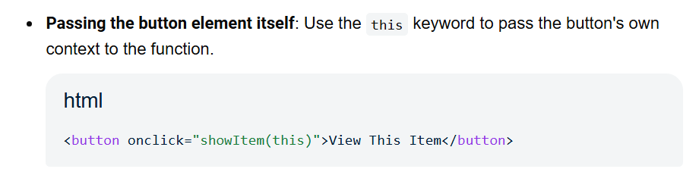
how to call functions inline – event "attributes"
<!-- The HTML Button -->
<button onclick="showItem()">Click to Show Item</button>
<!-- The 'return' keyword tells the form whether to submit or stop --> <form action="/submit-page">
<button type="submit" onclick="return validateItem()">Submit</button> </form>

Slide 18
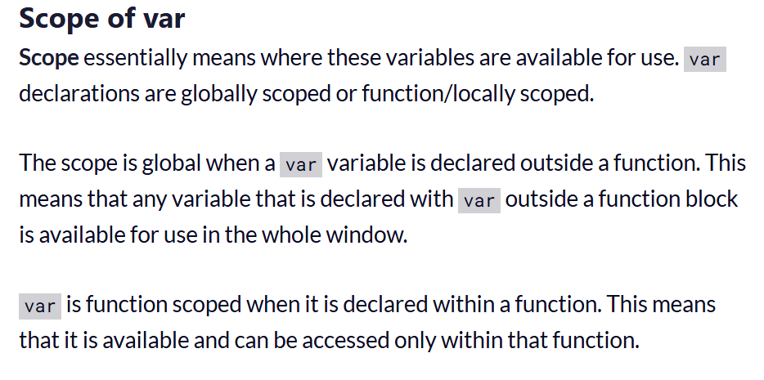
var, let, const - var
TO DO: Open https://www.freecodecamp.org/news/var-let-and-const-whats-the-difference/

Slide 19
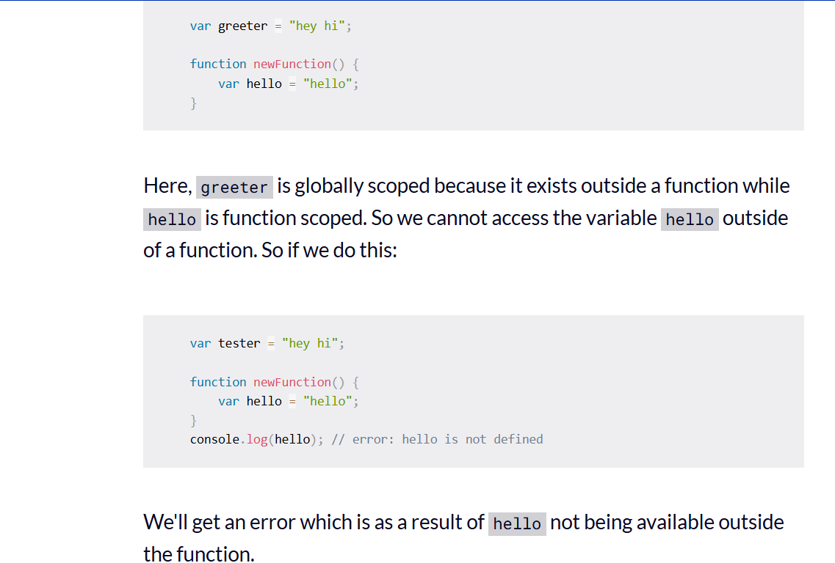
var scope

Slide 20
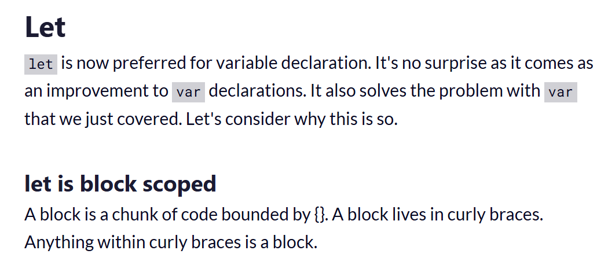
let scope

Slide 21
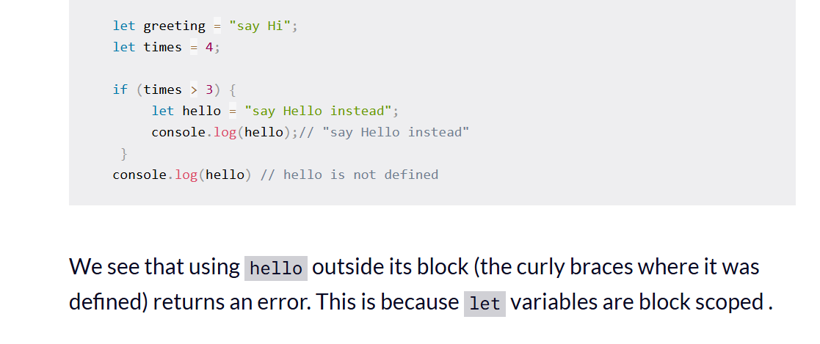
let scope

Slide 22
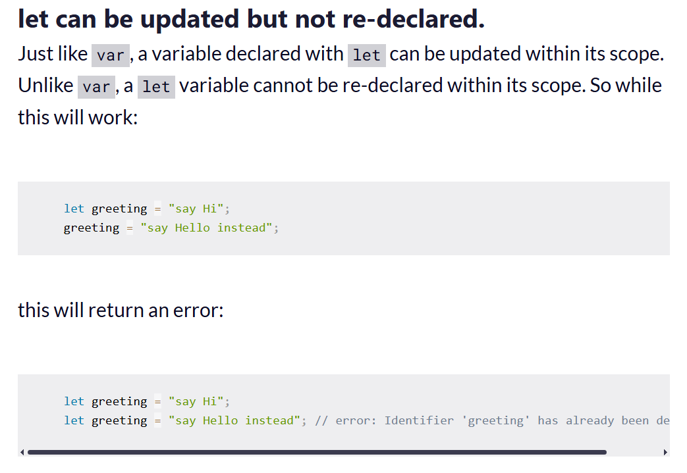
let scope

Slide 23
const scope
CONST
Variables declared with the const maintain constant values. const declarations share some similarities with let declarations.
const declarations are block scoped
Like let declarations, const declarations can only be accessed within the block they were declared.
const cannot be updated or re-declared
This means that the value of a variable declared with const remains the same within its scope. It cannot be updated or re-declared.
Every const declaration, therefore, must be initialized at the time of declaration.

Slide 24
Common events – page 125

Slide 25
The syntax for attaching an event handler

Slide 26
How to attach the event handler to the click event of a button – although a function, no () at the end
TO DO: Baxley project here.

Slide 27
To do: Develop the Income Tax Calculator

Slide 28
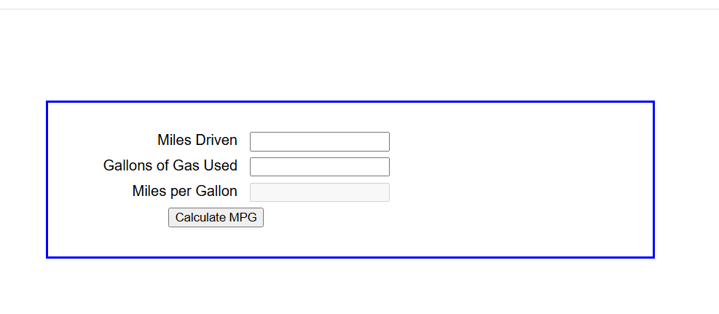
To do: convert MPG app
Use only the methods that we've learned so far; create the form in HTML

Slide 29

convert chapter three Future Value app
Use only the methods that we've learned so far;
create the form in HTML – create a main folder and correct subfolders

